Slide 1
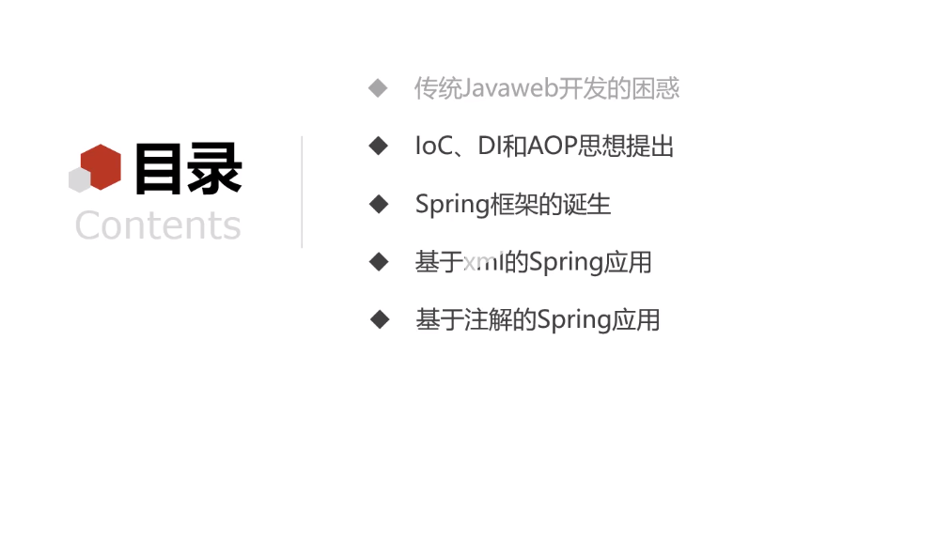

Slide 2
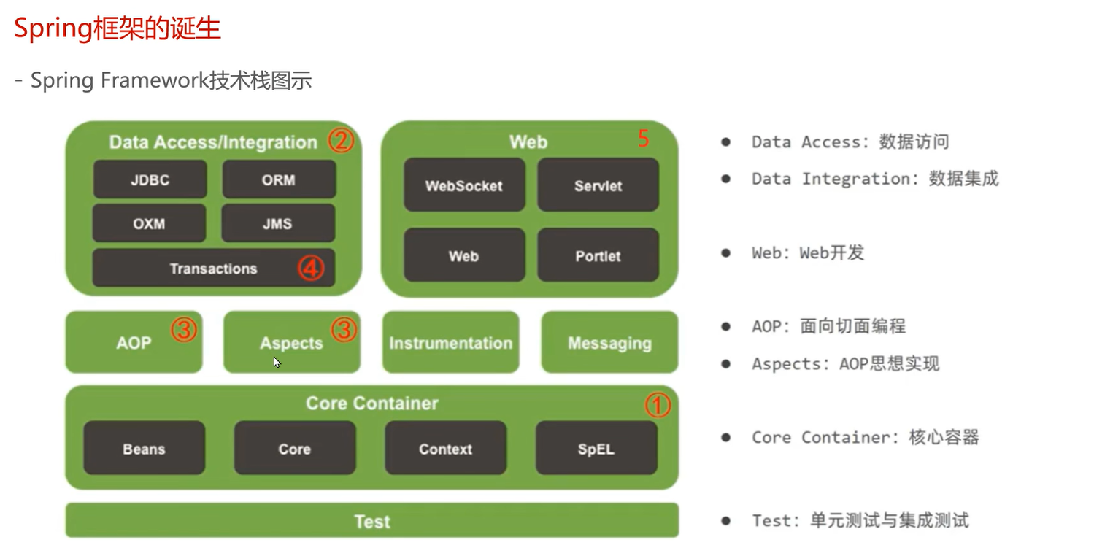

Slide 3
Bean Factory

Slide 4
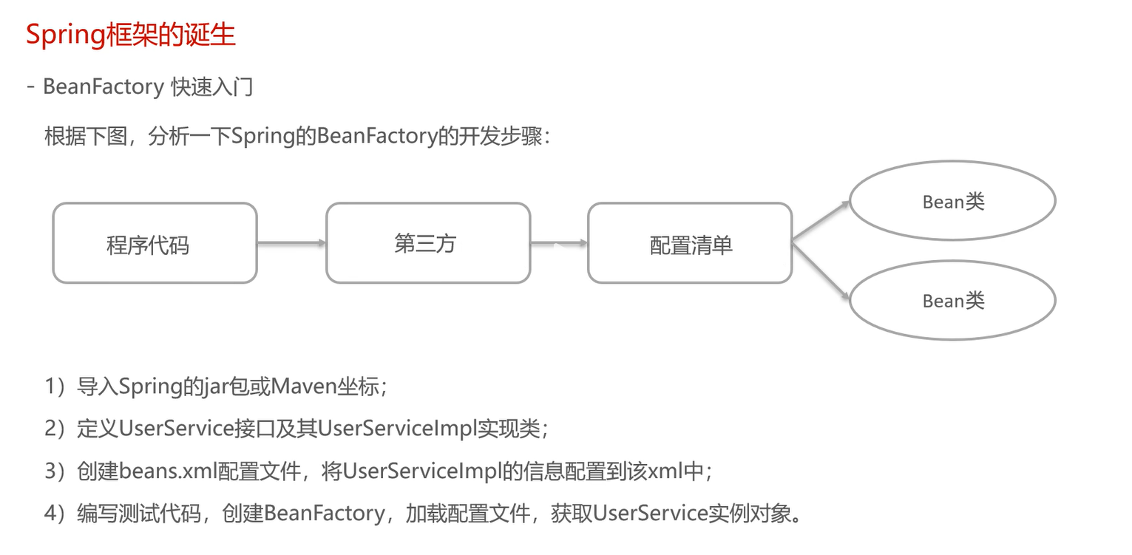

Slide 5
program
3rd party api (BeanFactory)
Configuration List
Bean Object
Bean Object

Slide 6
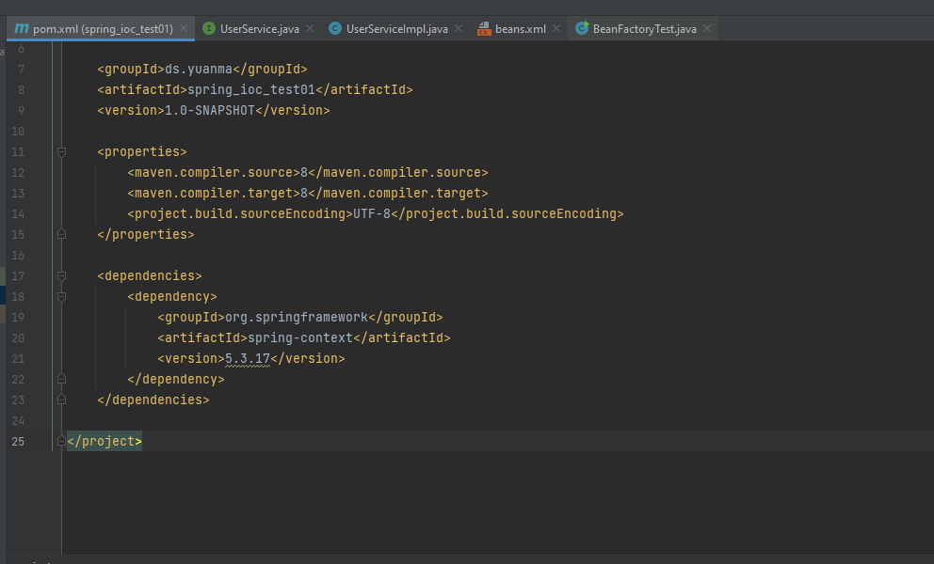

Slide 7
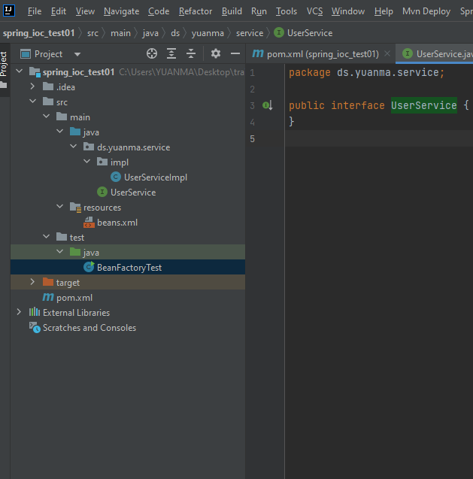
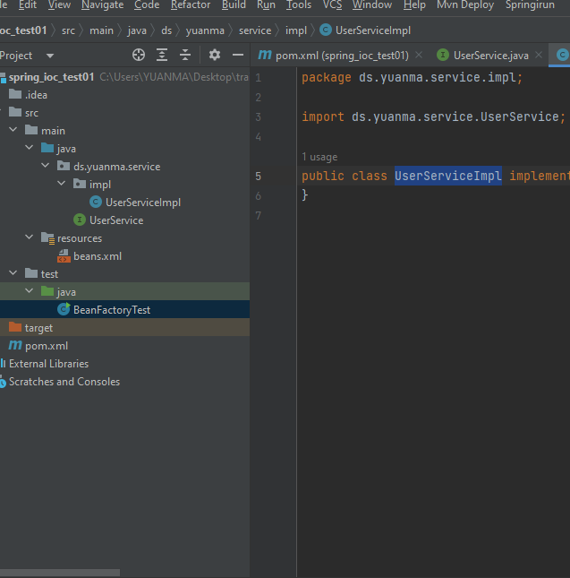

Slide 8
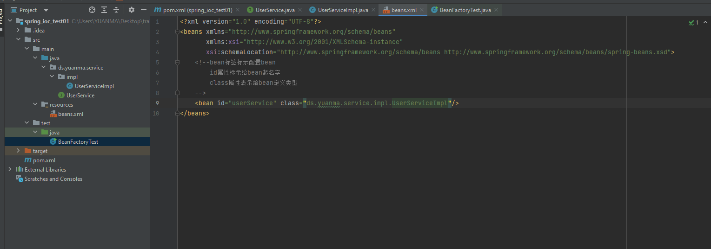

Slide 9
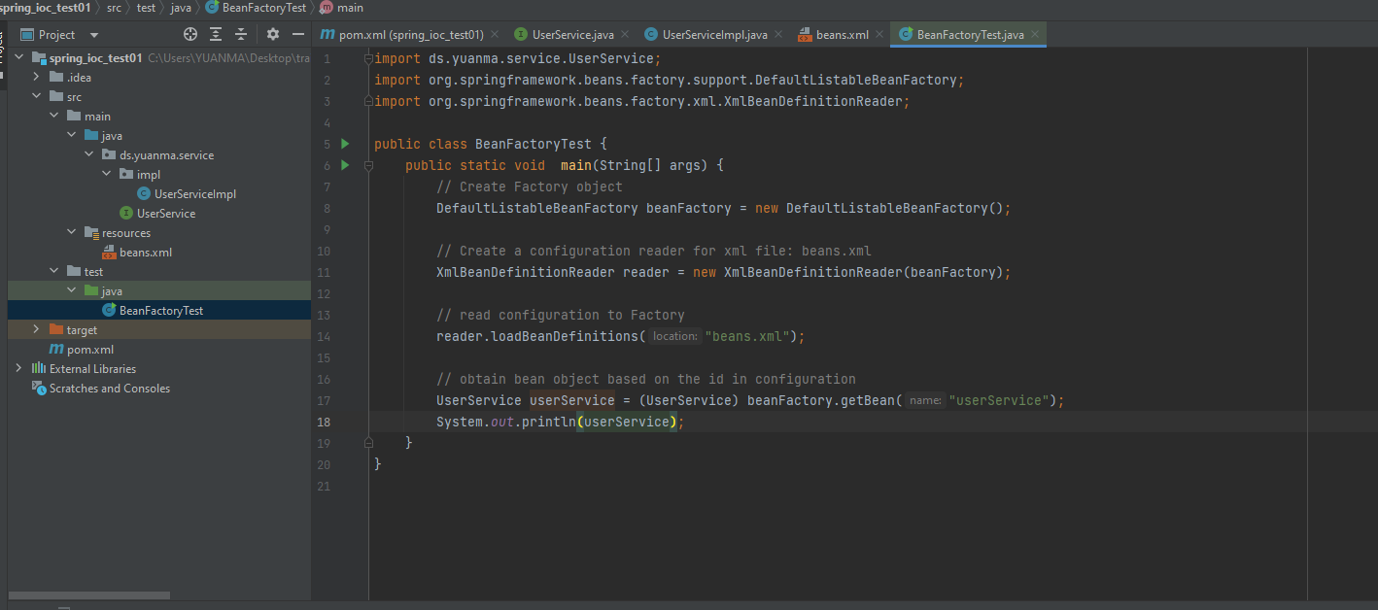
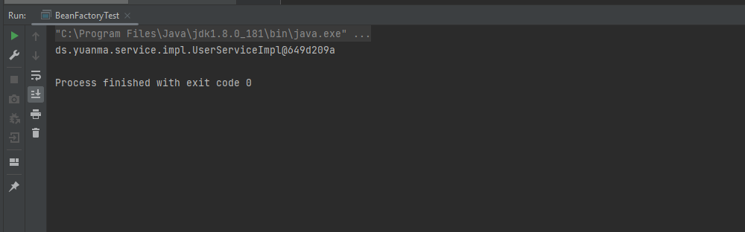

Slide 10
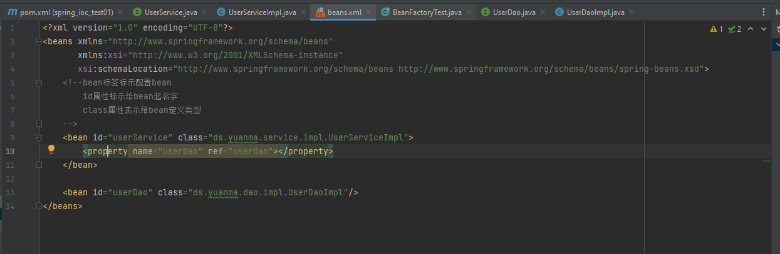
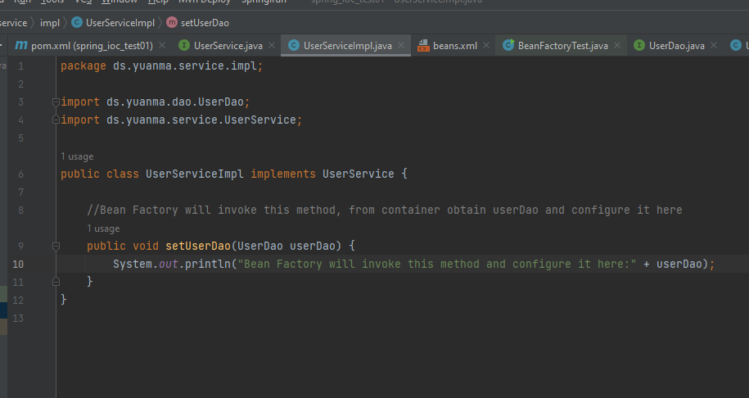

Slide 11
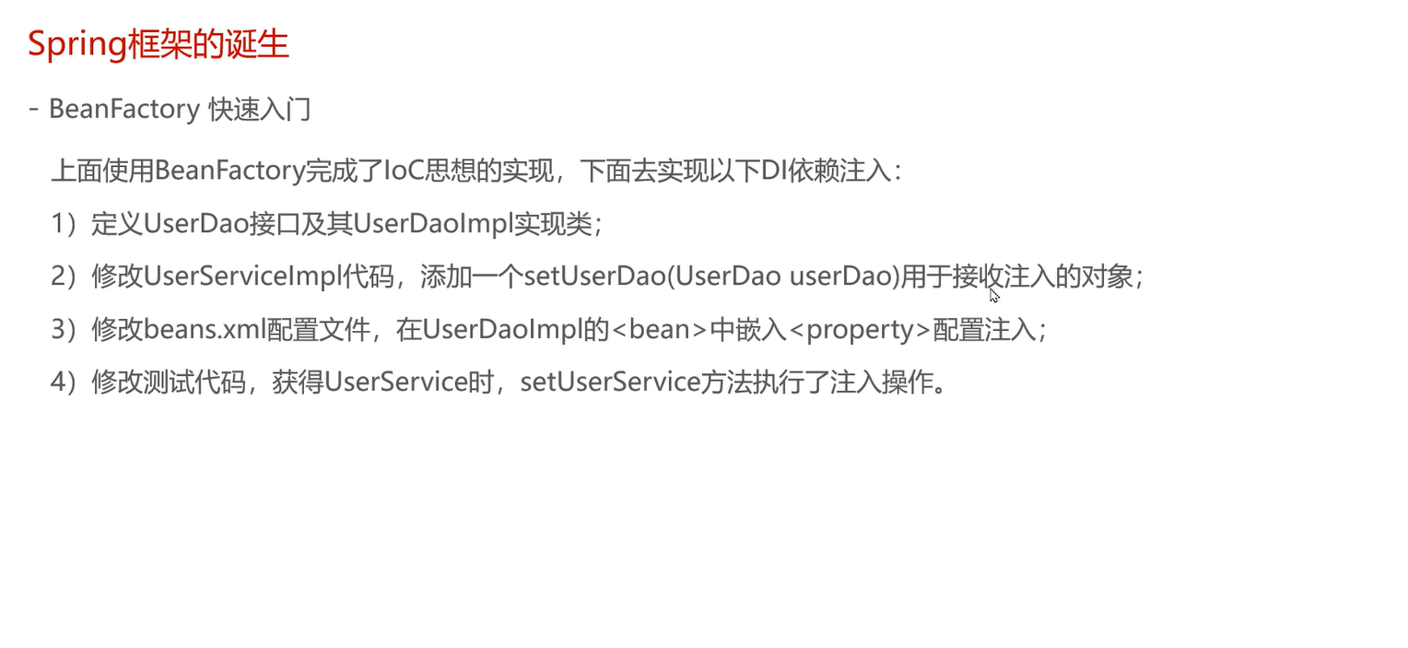

Slide 12
Application Context

Slide 13
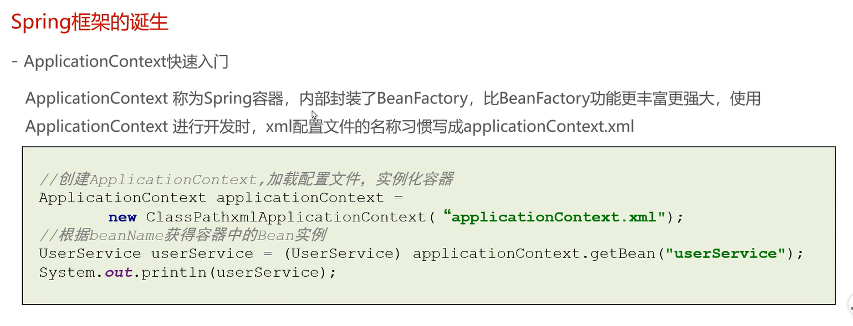

Slide 15
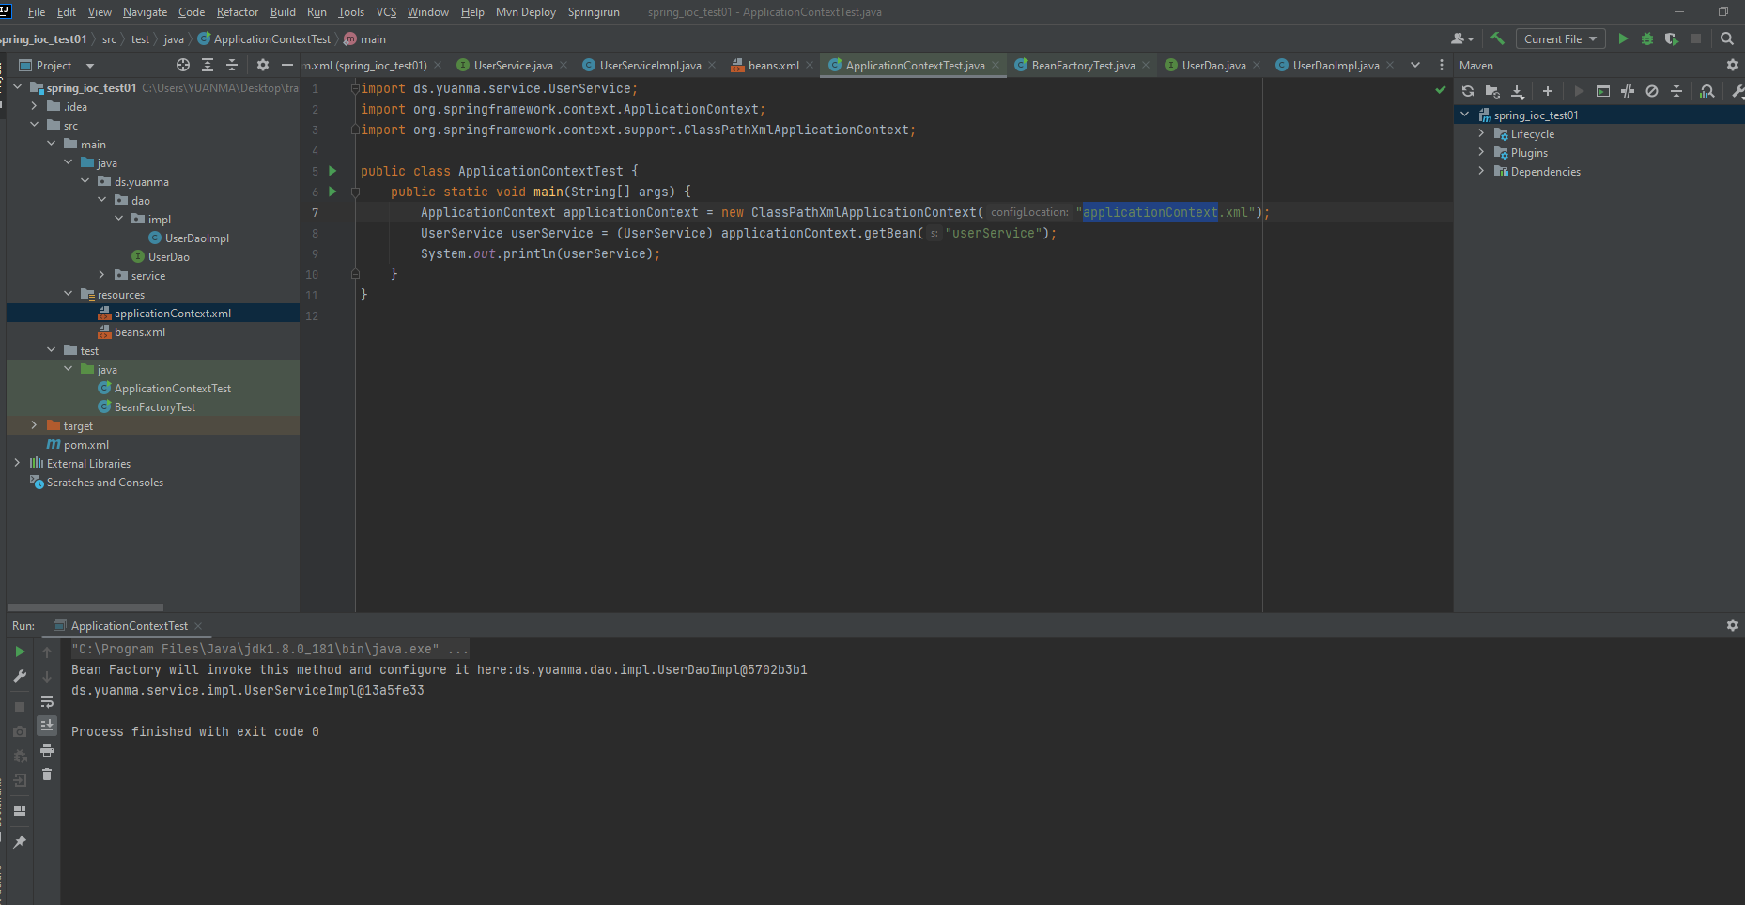

Slide 16
BeanFactory and ApplicationContext
Relationship & vs

Slide 17
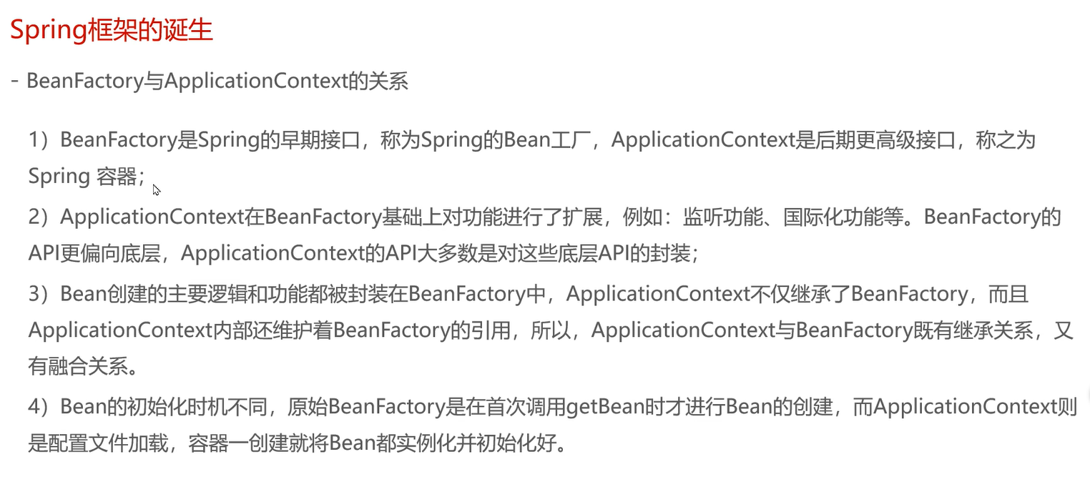

Slide 18
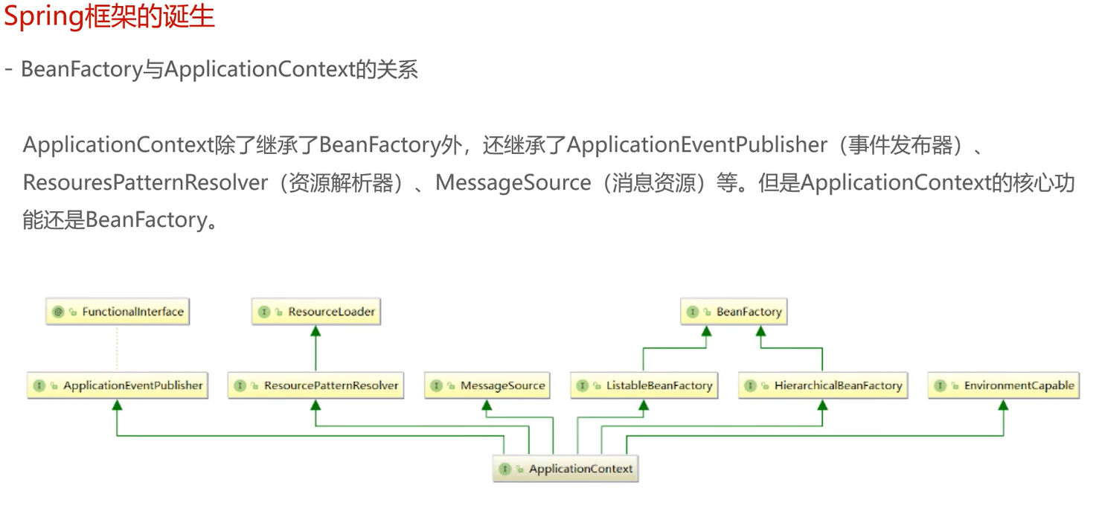

Slide 19
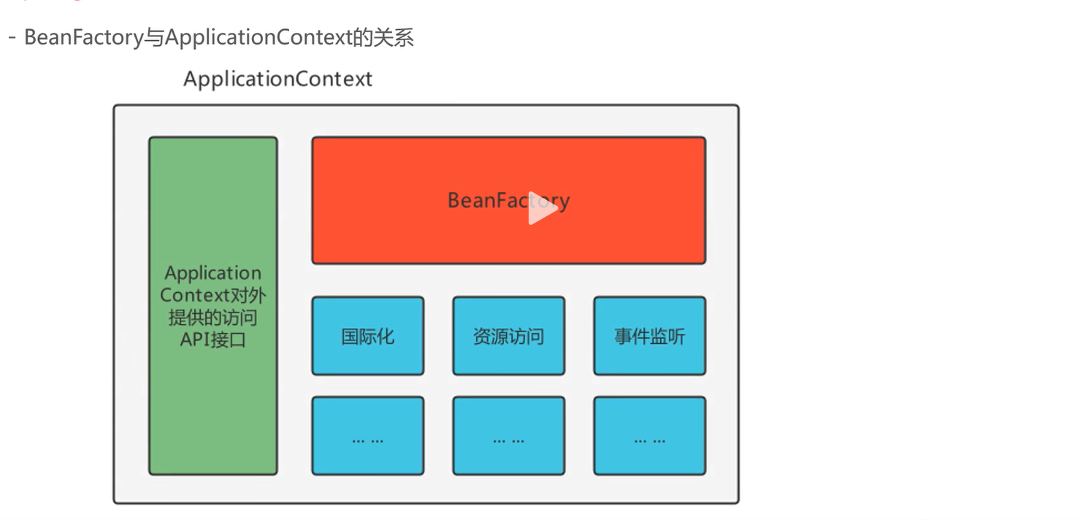

Slide 20
ApplicationContext API Interface
BeanFatory
internationalization (i18n)
Resource Access
… (MessageSource)
… (ResourceLoader)
Event Listener
…(ApplicationListener)

Slide 21
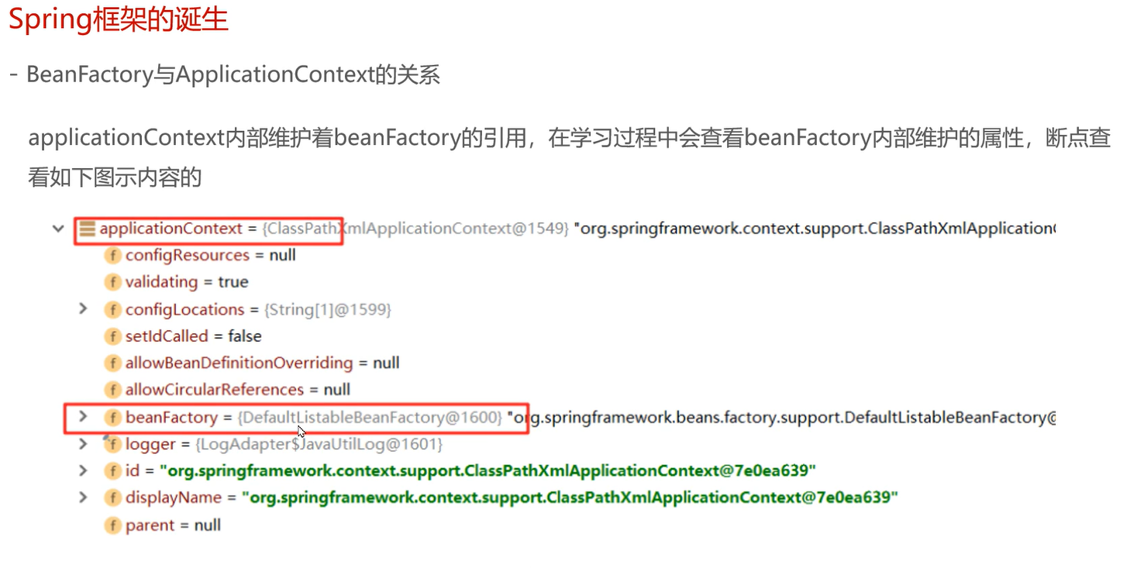

Slide 22
BeanFactory Inherit

Slide 23
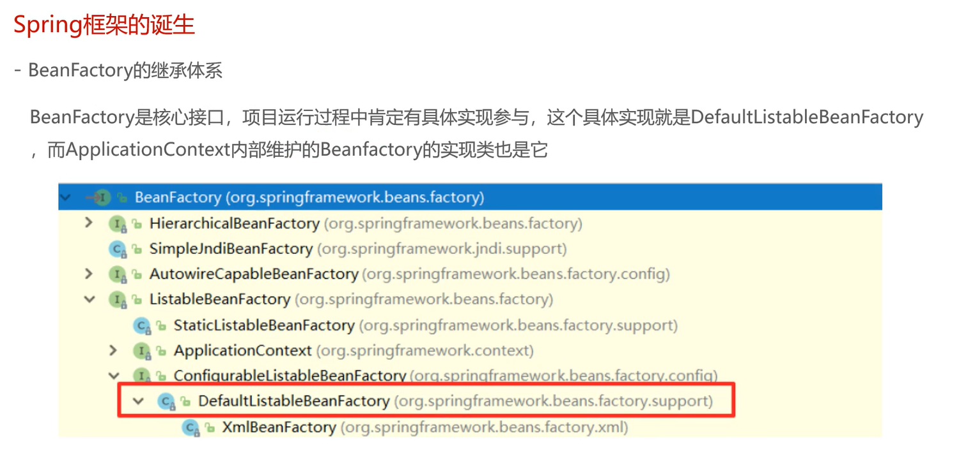

Slide 24
ApplicationContext Inherit

Slide 25
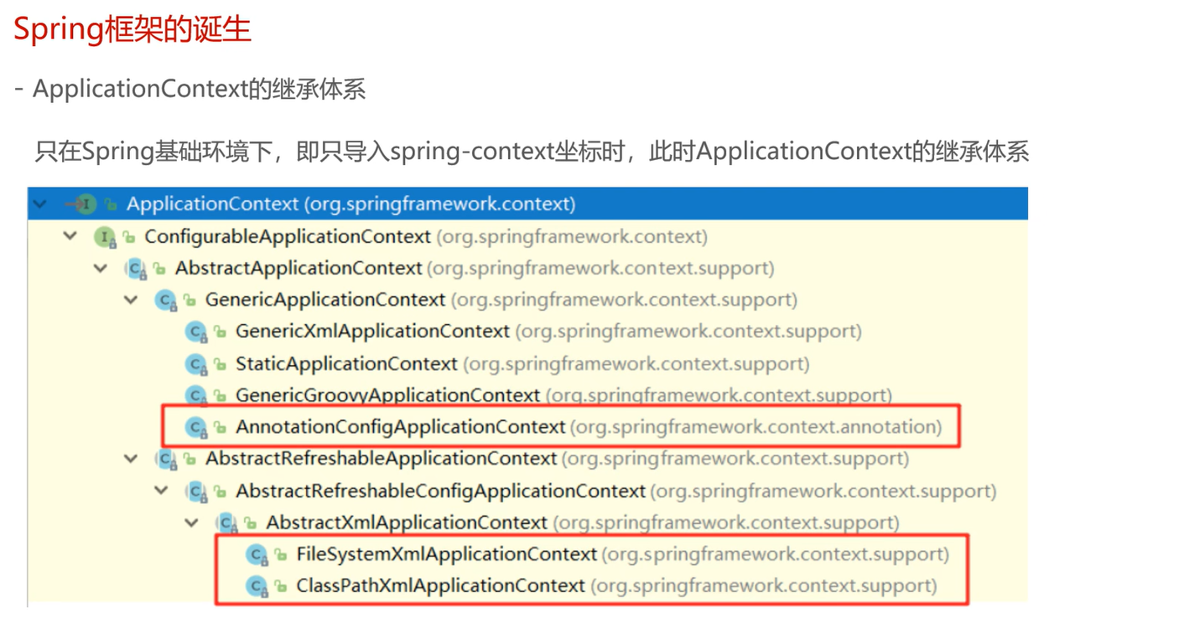

Slide 26
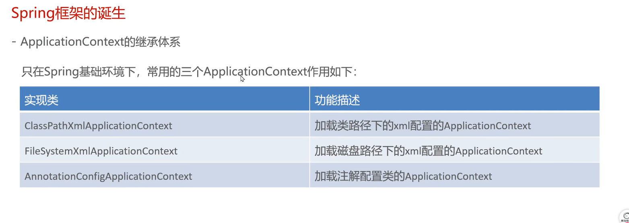

Slide 27
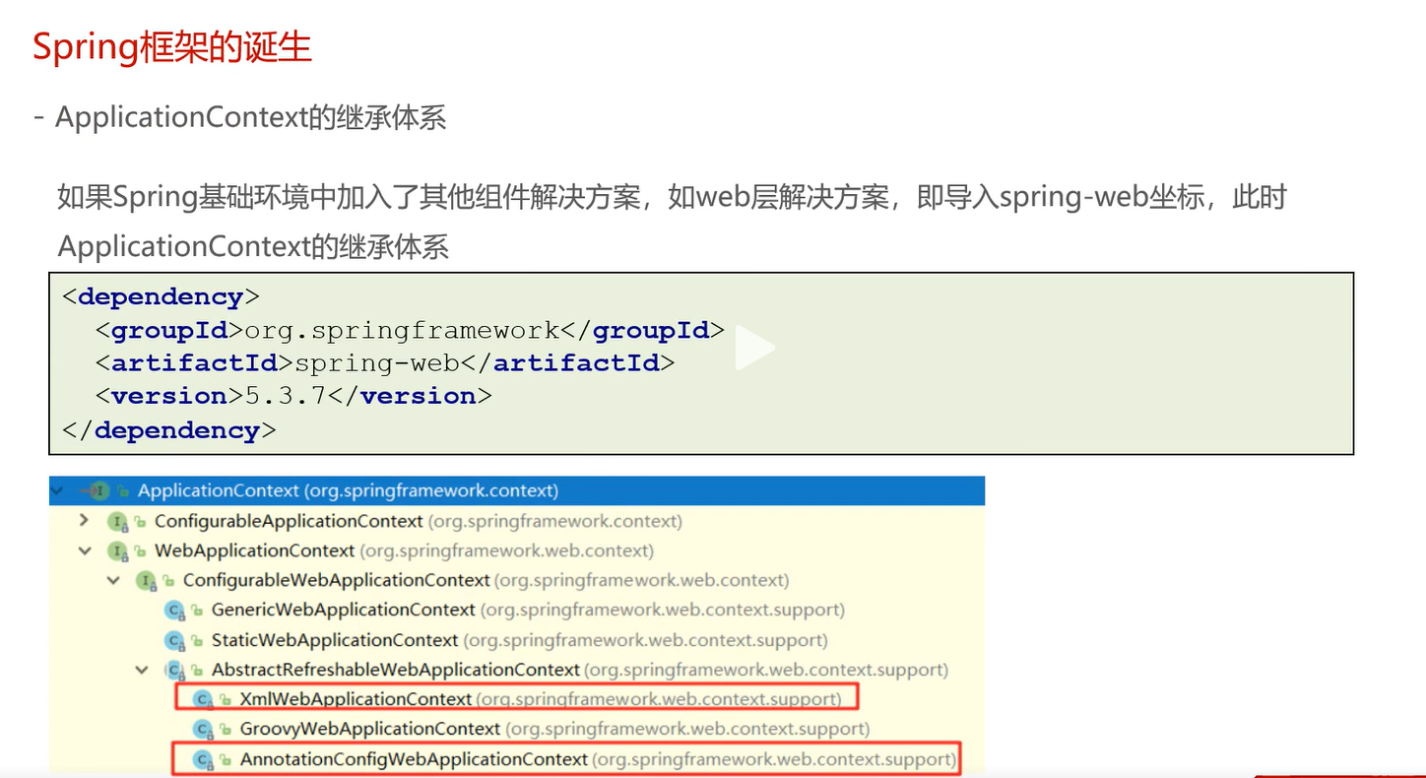

Slide 28
Xml Spring Application

Slide 29
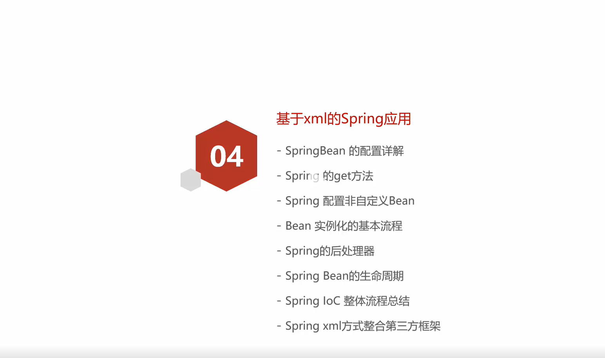

Slide 30
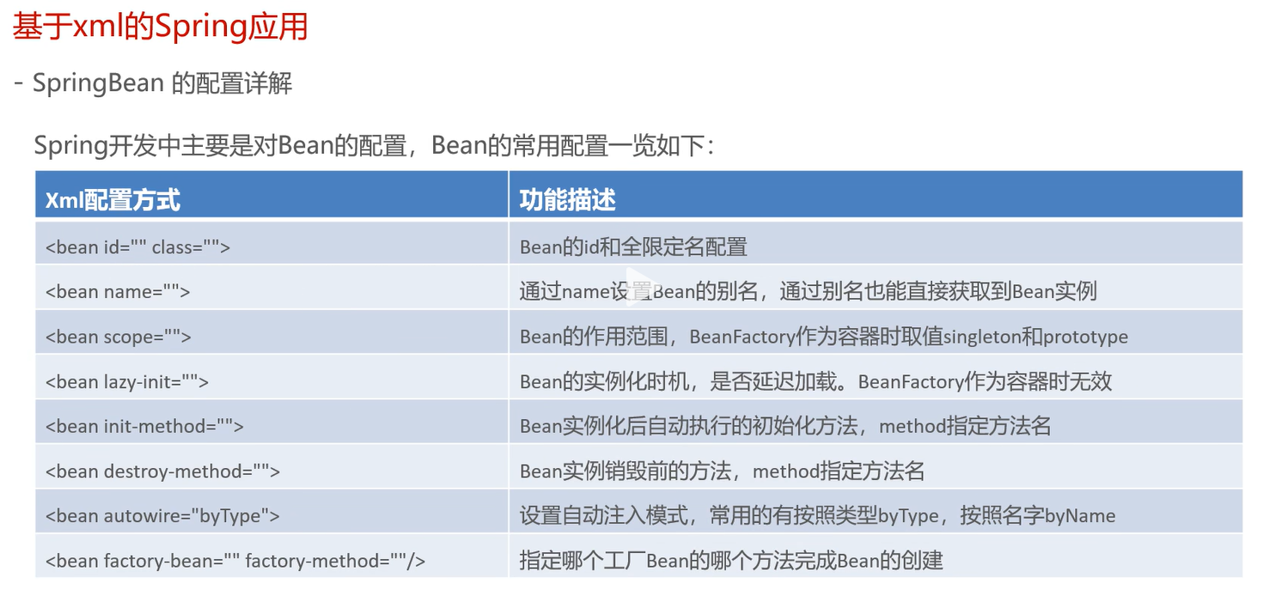

Slide 31
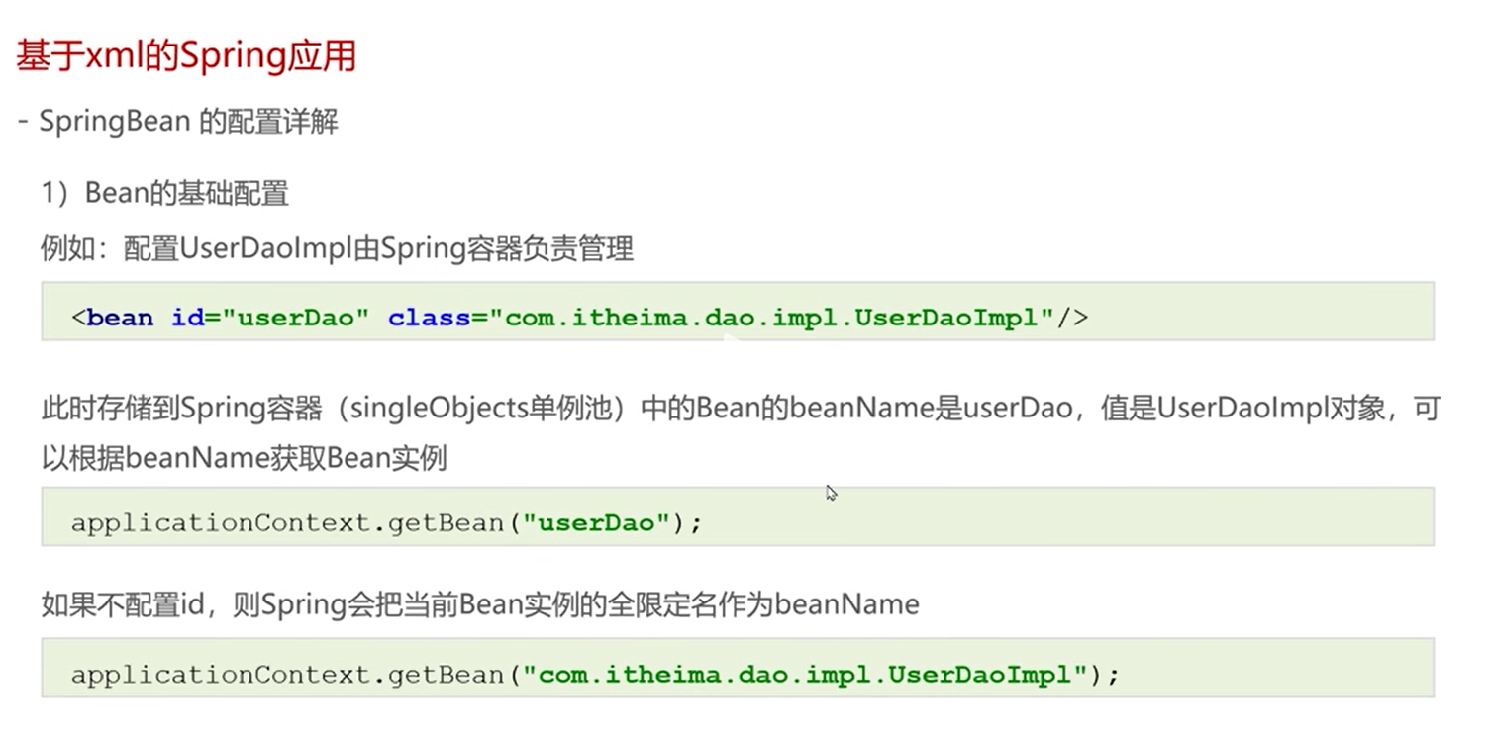

Slide 32
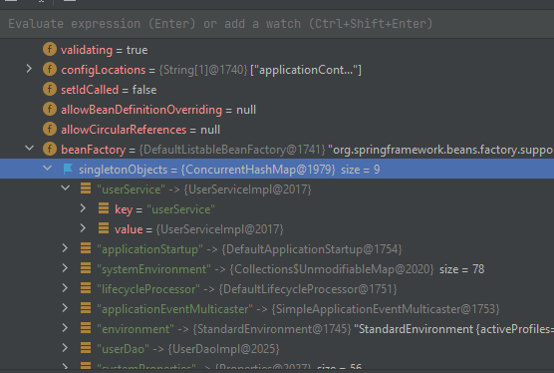
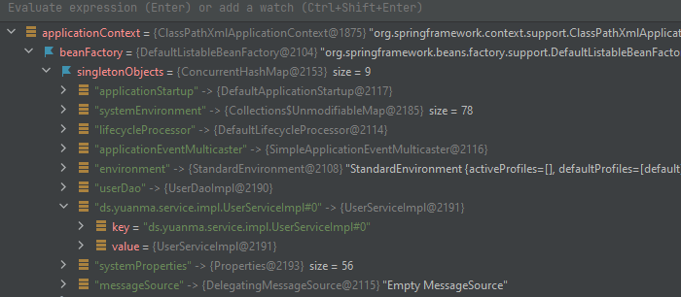
<bean id=“” class=“”> : Alias
Id will be converted as bean name
ClassPathXmlApplicationContext.getBean will get by bean name
Bean id
Bean name
applicationContext.getBean(“Bean name”)
If Bean id is defined
If Bean id is not defined
<bean class="ds.yuanma.service.impl.UserServiceImpl">

Slide 33
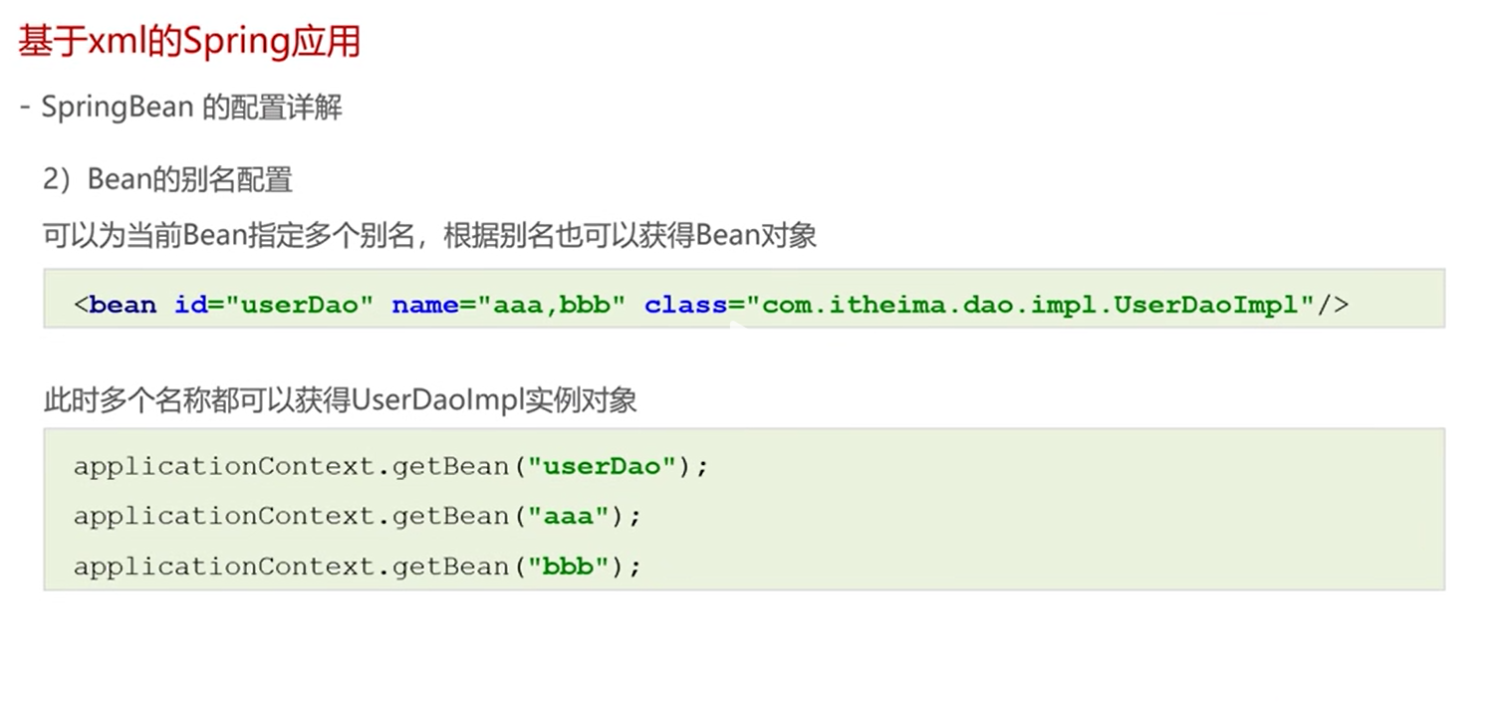

Slide 34
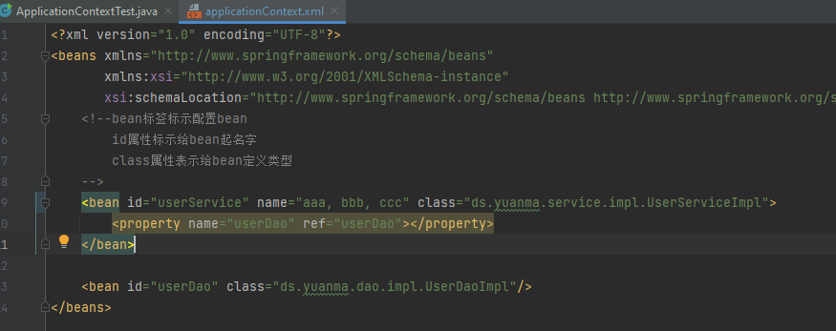
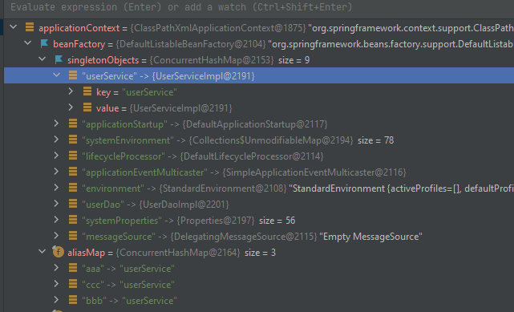
<bean name=“”> : Alias
If id is defined, the default Bean name is bean id
If id is not defined, but Bean name is defined, the 1st name is the Bean name

Slide 35
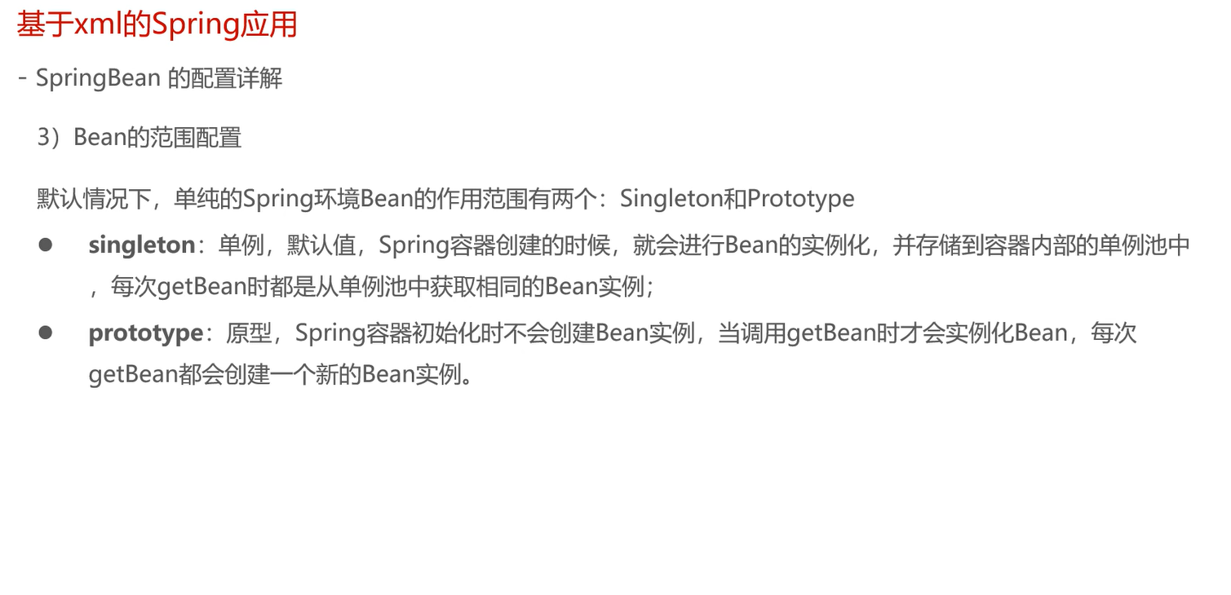

Slide 36
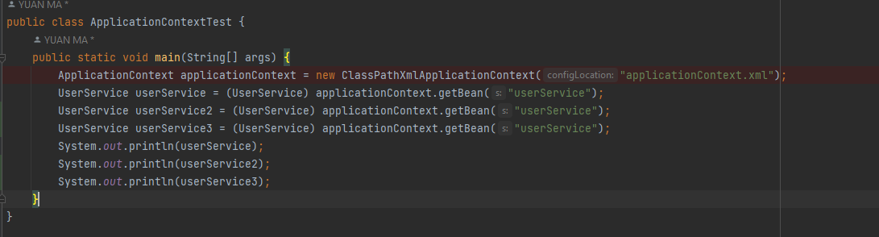
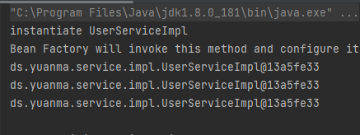
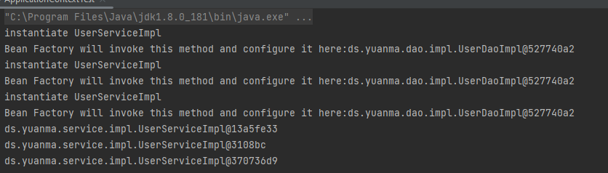
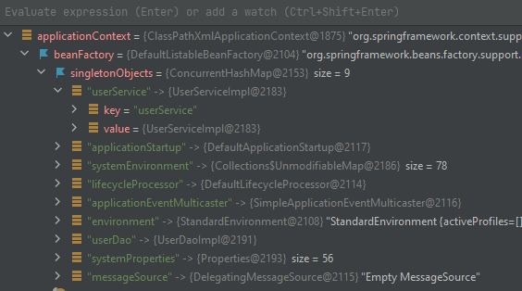
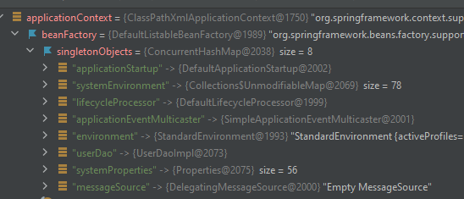
<bean scope=“singleton | prototype”> (spring-context)
If add dependency: spring-webmvc
Singleton
Prototype
Request
session
<bean scope=“singleton”>
<bean scope=“prototype”>
No service in <singletonObject> Pool!

Slide 37
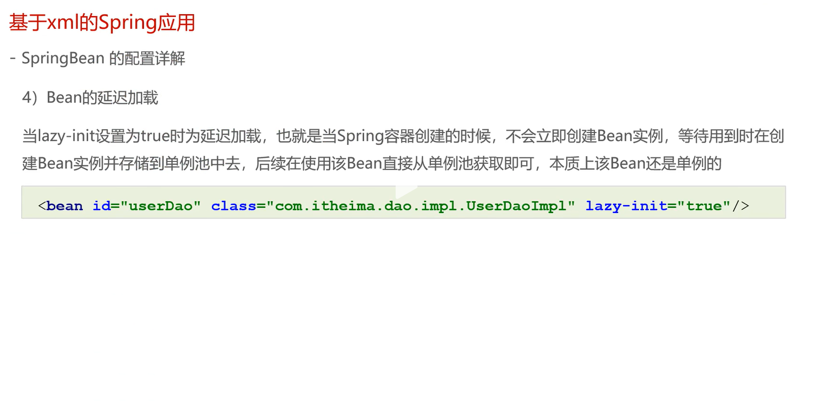

Slide 38
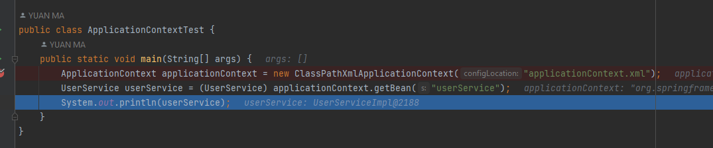
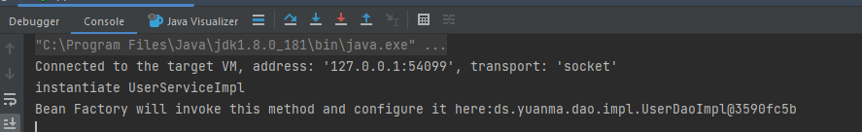
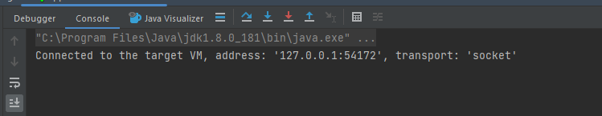
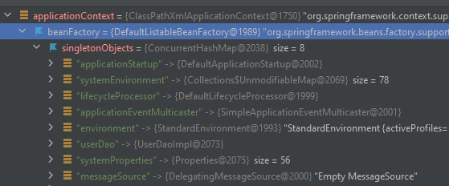
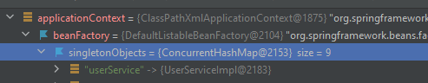
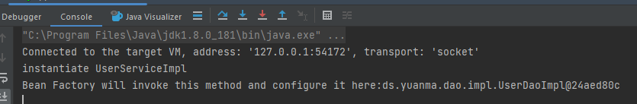
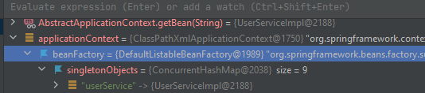
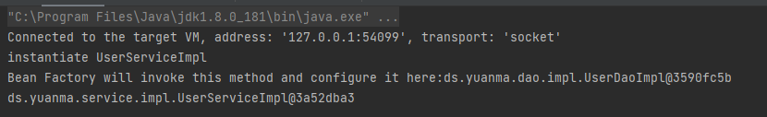
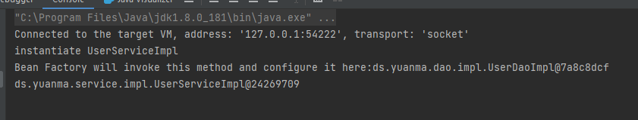
<bean lazy-init=“true | false”>
Not applicable for BeanFactorty
BeanFactory by default is lazy-inity
1
2
3
Execution seq
<bean lazy-init =“false”>
<bean lazy-init =“true”>
1
2
3

Slide 39
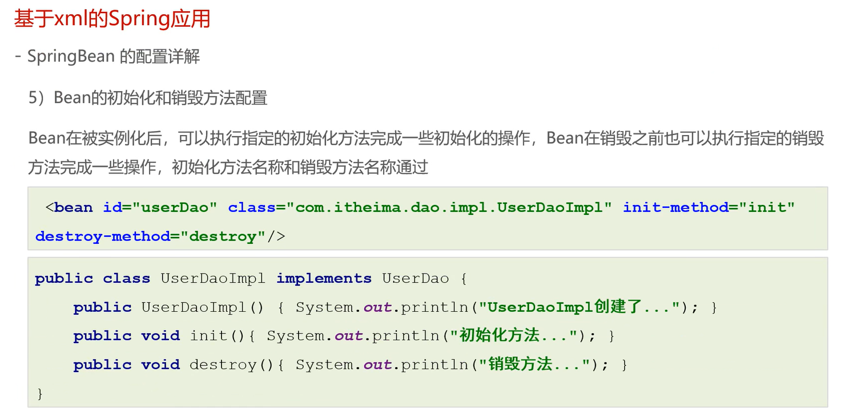

Slide 40
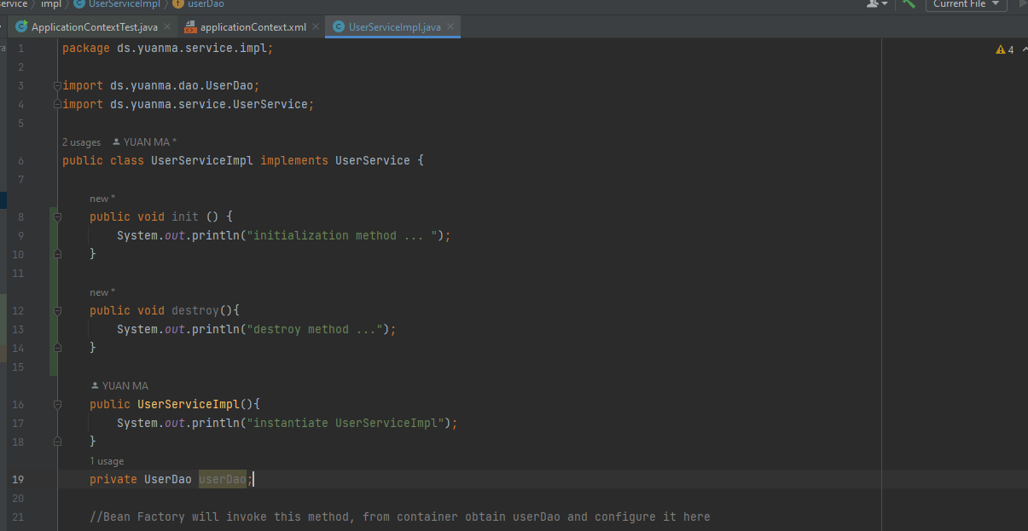
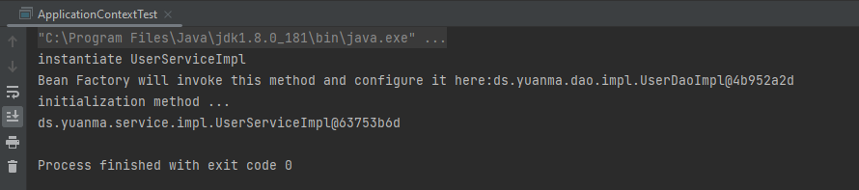
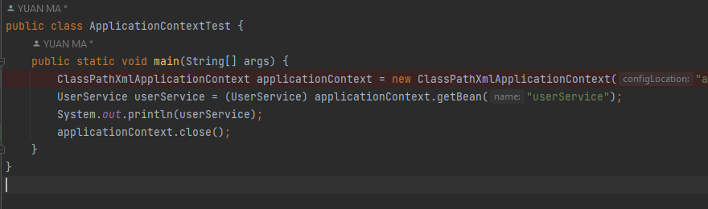

<bean init-method="" destroy-method="" >
instantiate
Init()
To destroy

Slide 41


1. Instantiate bean object
2. Set properties for bean
3. Init after properties set
4. Init method

Slide 42


Slide 43


Slide 44


Slide 45





Slide 46




Slide 47






Slide 48


Slide 49


Slide 50


Slide 51


Slide 52


Find set{Name}; where set property name allocated

Slide 53


Find property type allocated
Cannot Find which one to be allocate and wire to

Slide 54


User defined

Slide 55


Slide 56


Slide 57


No space!!!

Slide 58


Slide 59


Slide 61


Slide 62
getBean() method | Return & Parameters
Object getBean(String beanName) | Obtain Bean from container by beanName Require bean uniqueness in container Return object => Need Type Casting
T getBean(Class type) | Obtain Bean from container by Class type Require bean class type uniqueness in container Return Class object, don’t need type casting
T getBena(String beanName, Class type) | Obtain Bean from container by beanName Return Class object, don’t need type casting

Slide 63


Slide 64



Slide 65



Convention java setup
Spring setup

Slide 66


Slide 67


Slide 68


Slide 69




Mybatis config: https://mybatis.org/mybatis-3/getting-started.html
Convention java instantiate
Spring setup

Slide 70


Slide 71


Slide 72


Slide 73


Encapsulate

Slide 74


Slide 75


Slide 76



Slide 77


Slide 78


Slide 79



Slide 80



BeanFactoryPostProcessor

Slide 81




BeanFactoryPostProcessor: Bean modification

Slide 82


BeanFactoryPostProcessor: Bean registration

Slide 83


Slide 84




Slide 85




Grand papa
BeanFactoryPostProcessor: postProcessBeanFactory
Run order
inherent
papa
BeanDefinitionRegistryPostProcessor: postProcessBeanFactory
inherent
Run order
child
BeanDefinitionRegistryPostProcessor: postProcessBeanDefinitionRegistry

Slide 86


Slide 87


Slide 88


Slide 89


Slide 90


Slide 91


Slide 92



Slide 93


Slide 94


Slide 95





Slide 96







Slide 97




postProcessBeforeInitialization
InitializingBean: afterPropertiesSet
init-method: init
postProcessAfterInitialization

Slide 98


Slide 99

Java little knowledge: Proxy class

Slide 100


Slide 101



Slide 102



Slide 103


Slide 104


Slide 105



Slide 106


Slide 107


Slide 108




Slide 109





Slide 110





Slide 111



Slide 112




Slide 113


Slide 114






InvocationHandler.invoke()

Slide 115


Slide 116


Slide 117


Slide 118


Slide 119


Slide 120






Slide 121


Slide 122

Basic Process will stuck into a Dead loop

